Slide 1
Myths of the Arab Spring
1
Was the Tunisian revolution peaceful?
Al-Ayham Saleh
www.alayham.com

Slide 2
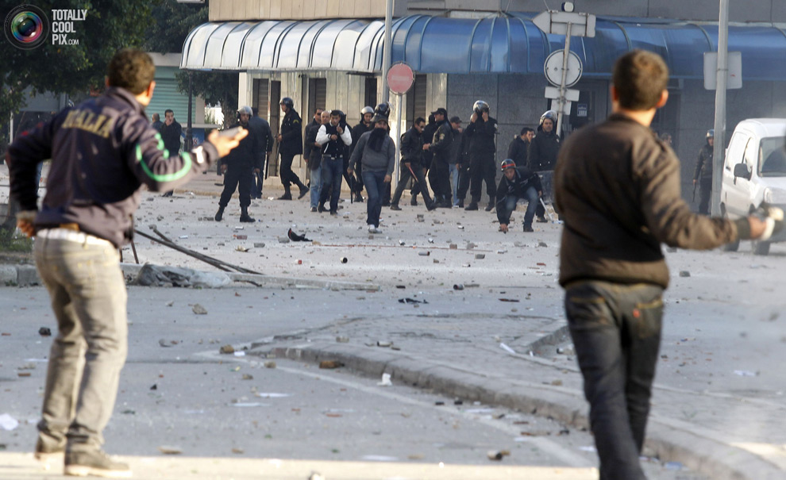
Tunis 14-01-2011
Rioters attacking the police

Slide 3
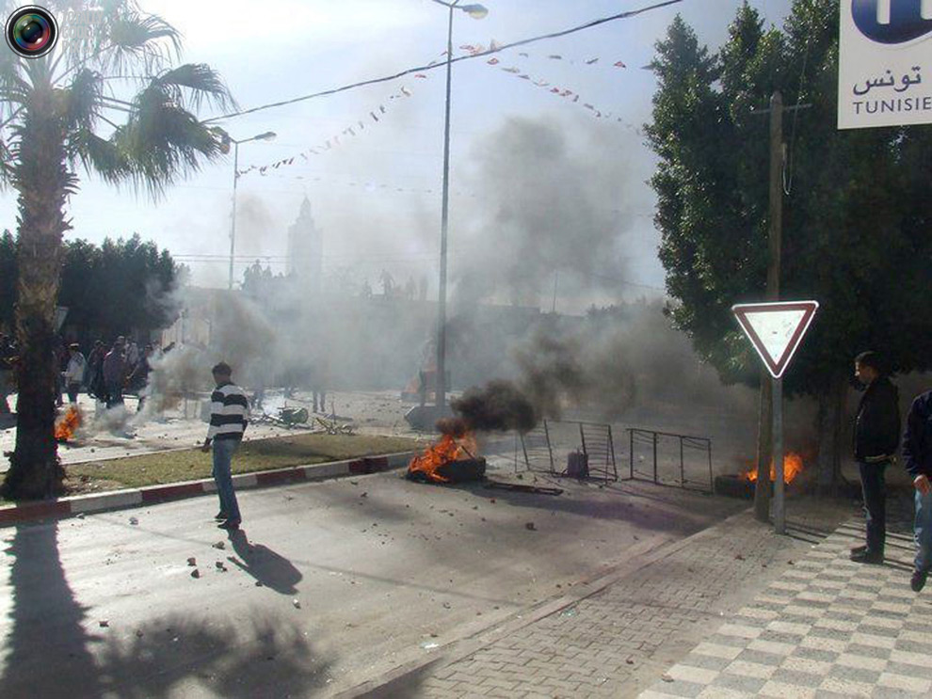
Sidi bouzid 10-01-2011
Barricades and burnt tyres

Slide 4
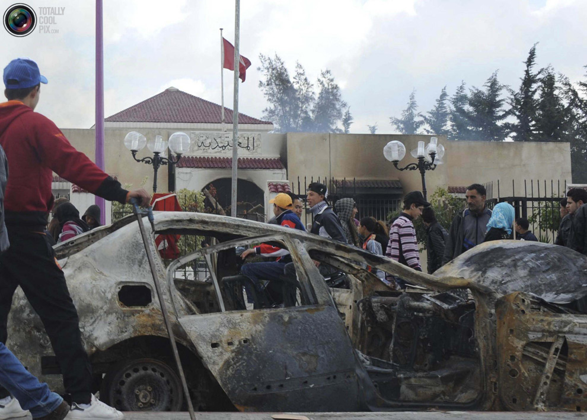
Sidi bouzid 13-01-2011
Burning government buildings

Slide 5
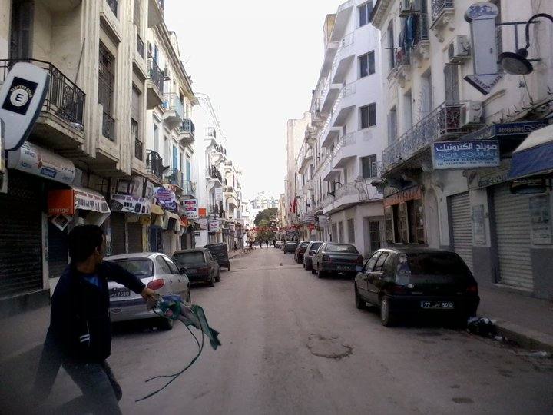
Tunis 13-01-2011
What is this guy doing?

Slide 6
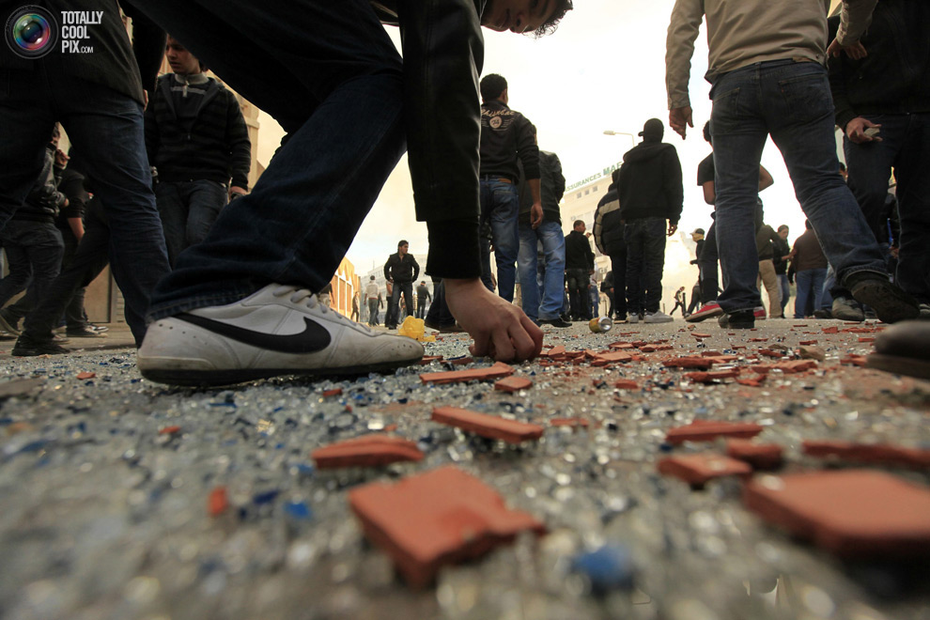
Tunis 14-01-2011
The battle ground

Slide 7
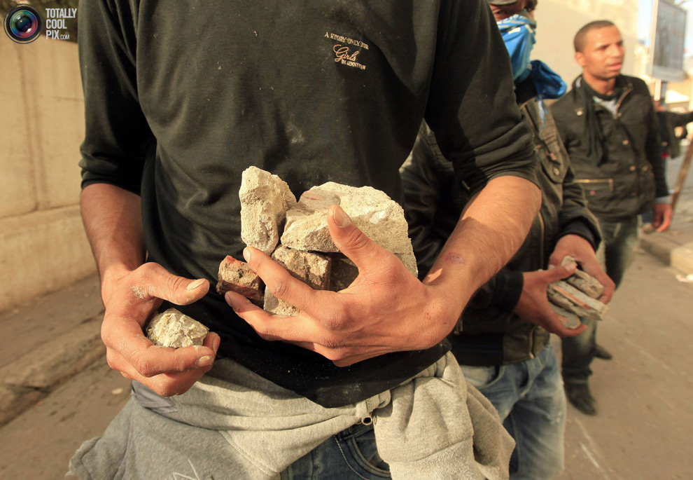
Tunis 14-01-2011
Prepare to attack

Slide 8
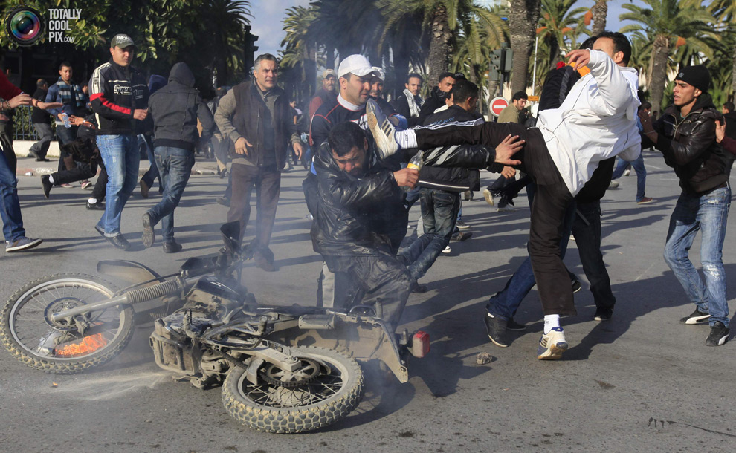
Tunis 14-01-2011
They even hit each other

Slide 9
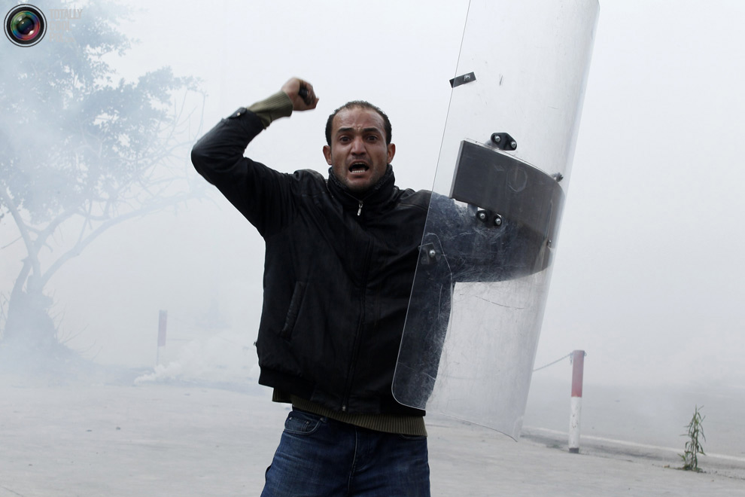
Tunis 14-01-2011
Victory over the police

Slide 10
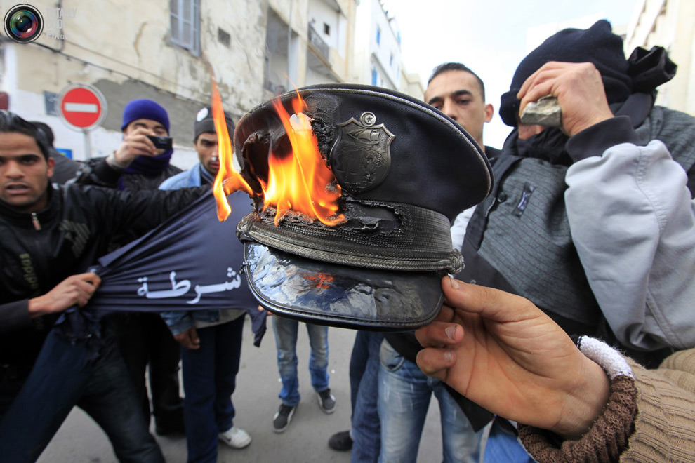
Tunis 14-01-2011
What did you do to the police man?

Slide 11
How did the regime deal with them?

Slide 12
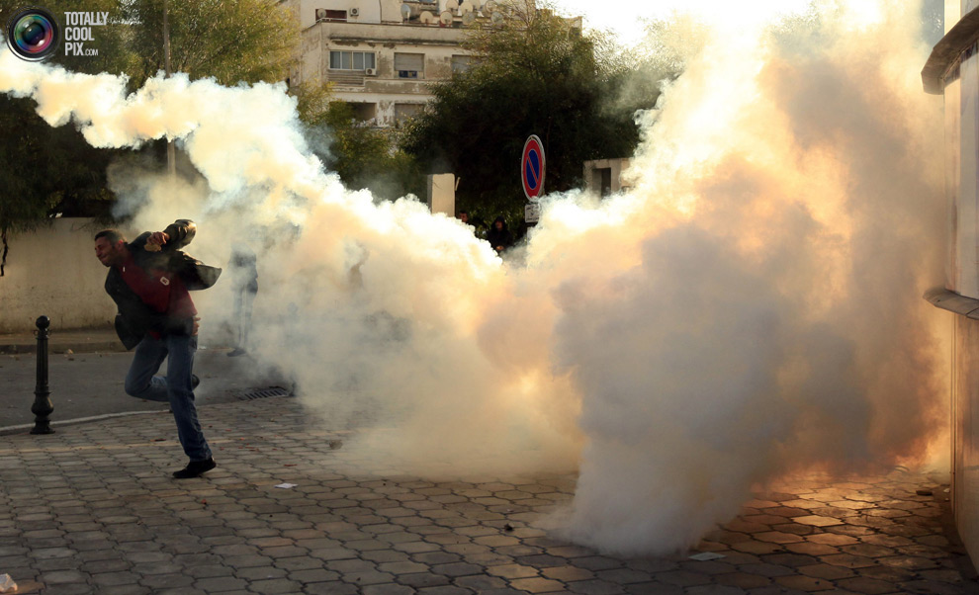
Tunis 14-01-2011
Police used tear gas

Slide 13
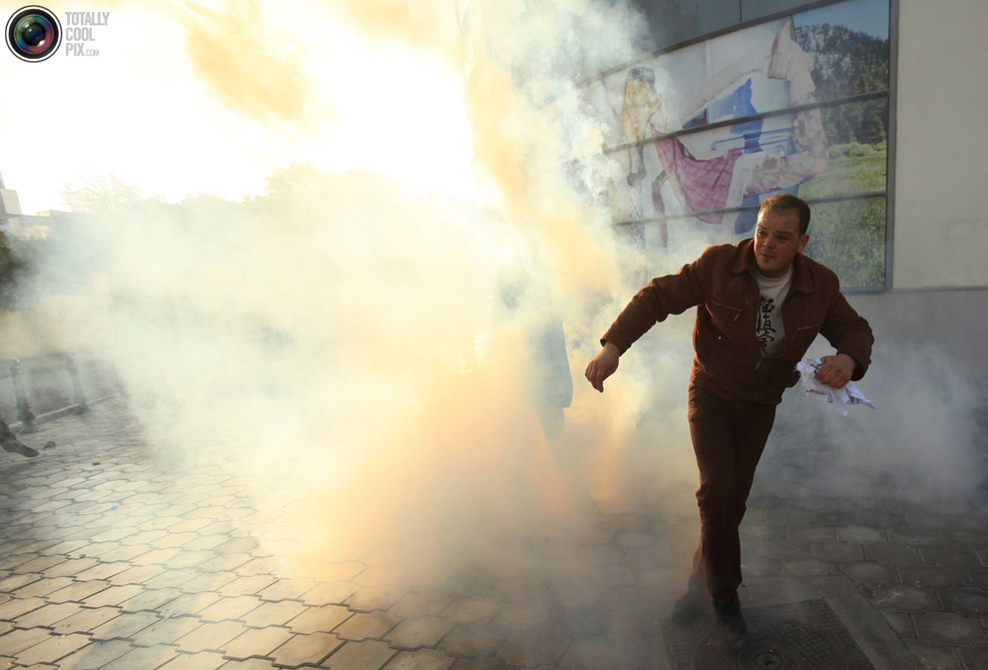
Tunis 14-01-2011 only a few canisters

Slide 14
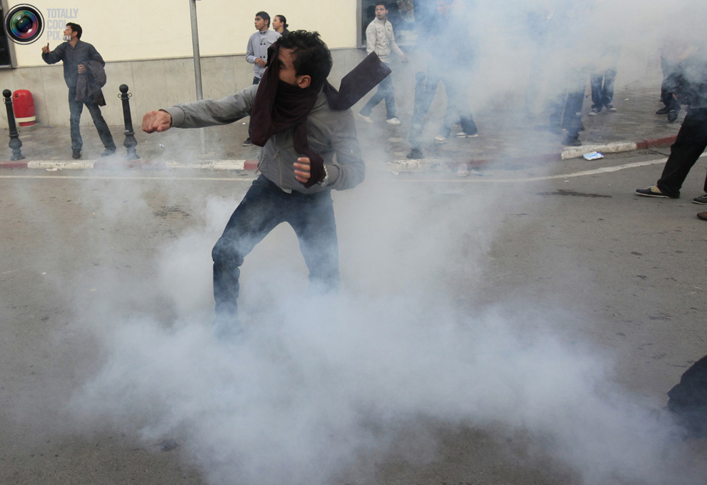
Tunis 14-01-2011
They were prepared!!

Slide 15
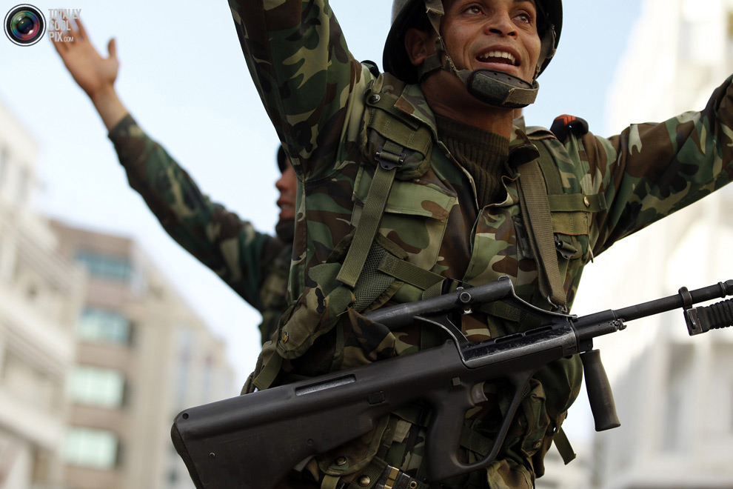
Tunis 14-01-2011
How the army responded!!

Slide 16
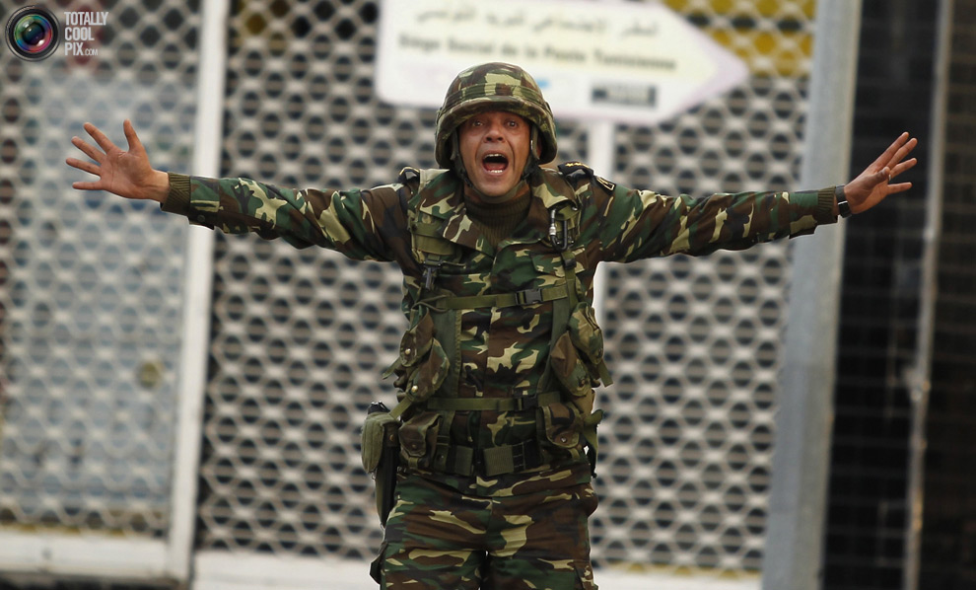
Tunis 14-01-2011
An army officer!

Slide 17
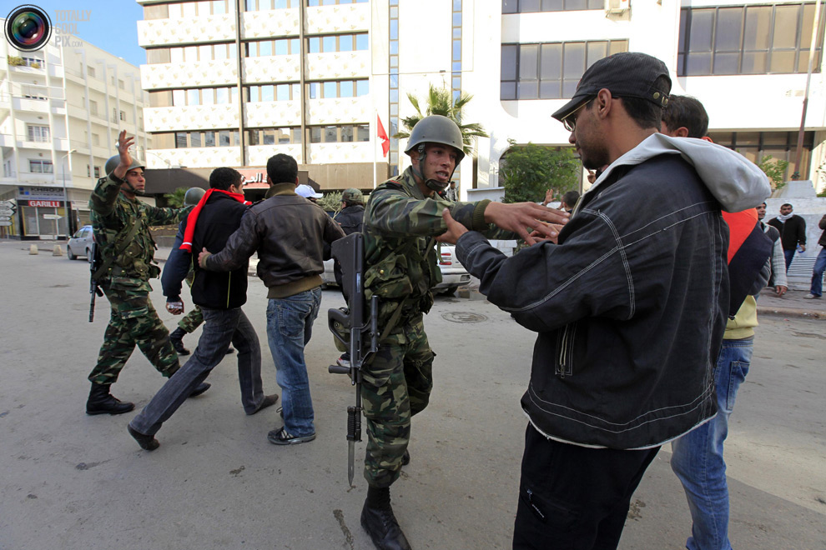
Tunis 14-01-2011
Please go home…

Slide 18
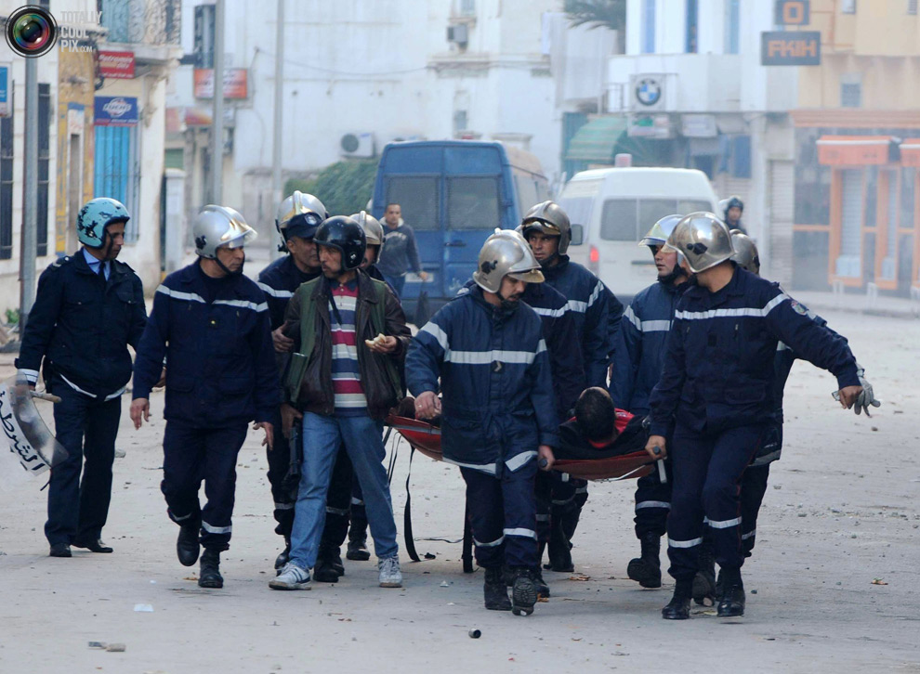
Tunis 13-01-2011
Police saves a man

Slide 19
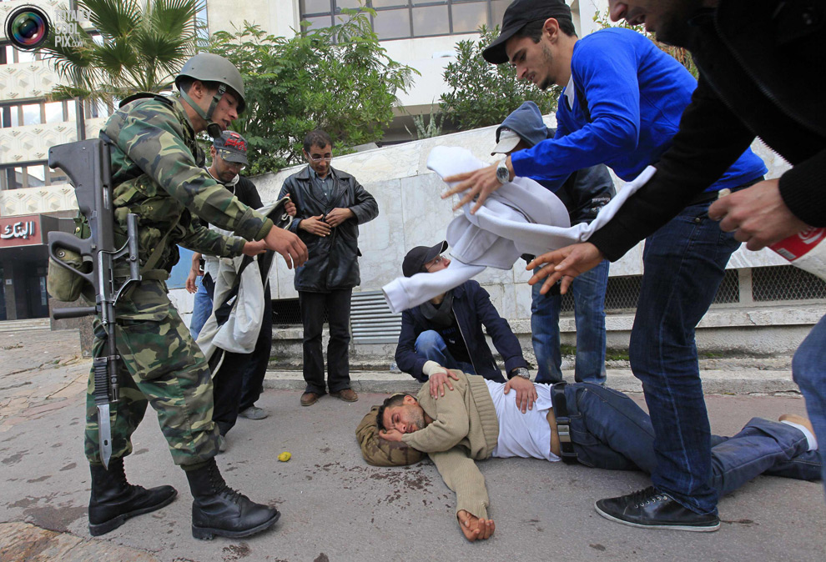
Tunis 14-01-2011
The army is helping…

Slide 20
Do NOT Believe,
INVESTIGATE
Al-Ayham Saleh
www.alayham.com

